Slide 1

Struktur Data
Arrays
Prepared by
Frans Panduwinata, S.Kom, M.T

Slide 2
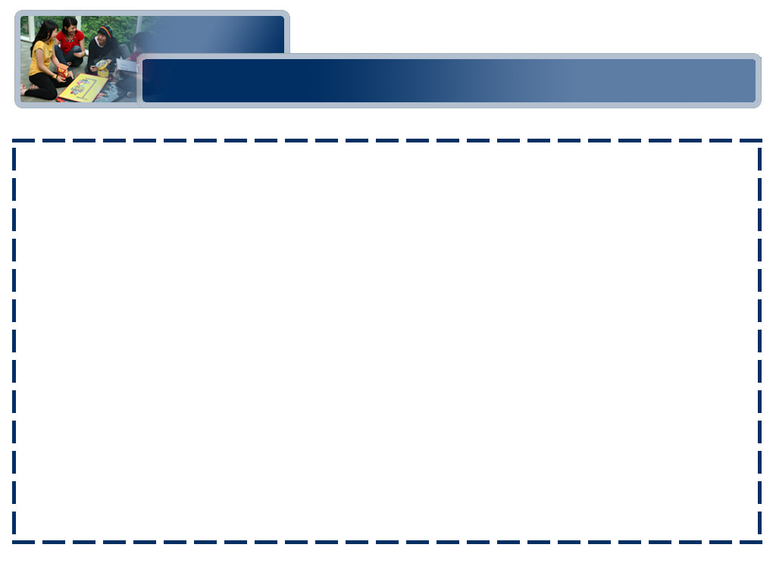
Abstract Data Type
Definition:
A set of data values and associated operations that are precisely specified independent of any particular implementation.
The important principle is that the definition abstract data type (ADT) of any abstract data type involves two parts:
  A description of the way in which the components are related to each other, and
  A statement of the operations that can be performed on elements of the abstract data type.

Slide 3
Abstract Data Type (cont)
EXAMPLE:
A stack of elements of type T is a finite sequence of elements of T, together with the following operations:
  Create the stack, leaving it empty.
  Test whether the stack is empty.
  Push a new entry onto the top of the stack, provided the stack is not full.
  Pop the entry off the top of the stack, provided the stack is not empty.
  Retrieve the Top entry from the stack, provided the stack is not empty.

Slide 4
Data Structure
Definition:
An organization of information, usually in memory, for better algorithm efficiency, such as queue, stack, linked list, heap, dictionary, and tree, or conceptual unity, such as the name and address of a person.
A data structure is the physical implementation of an ADT.

Slide 5
C++ Overview
The most important features of C++ for our study of data structures are:
  C++ allows data abstraction:
  This means that programmers can create new types to represent whatever collections of data are convenient for their applications.
  C++ supports object-oriented design,
  in which the programmer-defined types play a central role in the implementation of algorithms.

Slide 6
C++ Overview (cont)
The most important features of C++ for our study of data structures are (cont):
  C++ allows for the use of the top-down approach, which is familiar to C programmers.
  C++ facilitates code reuse, and the construction of general purpose libraries.

Slide 7
Arrays
An array
is a data structure used to process multiple elements with the same data type when a number of such elements are known.
A static array is defined as:
int list[20];
A dynamic one is defined as:
int* list; list = new int[25];

Slide 8
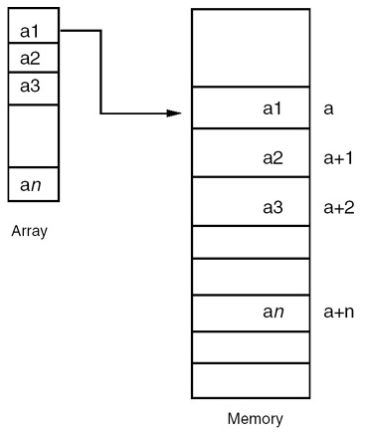
Arrays (cont)
Representation of an array

Slide 9
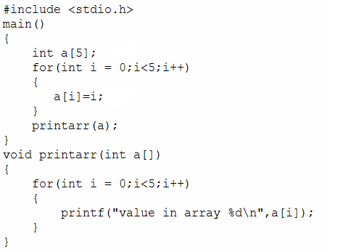
Arrays (cont)
EXAMPLE:

Slide 10
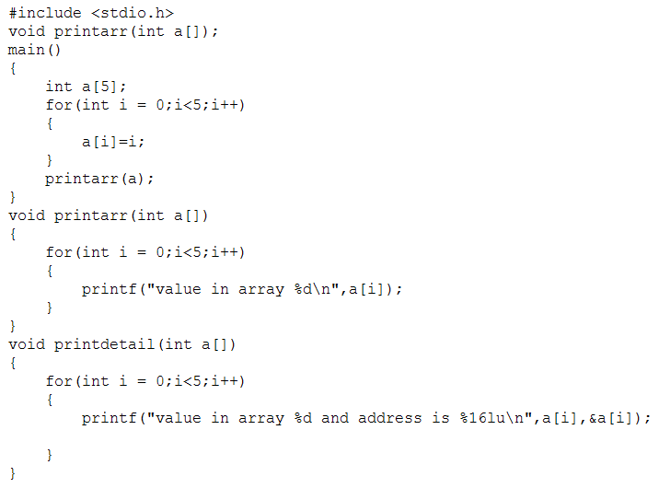
Arrays (cont)
Each element of the array has a memory address

Slide 11
Arrays (cont)
Operations on an Array:
  Retrieval of an element
  EXAMPLE:
cout<<data[5];
Print out 6th element of array data
  Search
  EXAMPLE:
for (int i=0;i<j;i++)
if(input==data[i]) {cout<<data[i];}
Search input value in array data

Slide 12
Arrays (cont)
Operations on an Array (cont):
  Insertion
  EXAMPLE:
for (int i=0;i<j;i++)
{cin>>data[i];}
Insert value to array data
  Deletion
  An array’s index must contain some value even some element in array is deleted. If a blank array is printed anyway, it will produce an invalid number such as -858993460

Slide 13
Functions
Functions are used to provide modularity and readability to the software.
By using functions, you can divide complex tasks into small manageable tasks.
The use of functions can also help avoid duplication of work.
For EXAMPLE,
if you have written the function for calculating the square root, you can use that function in multiple programs.

Slide 14
Functions (cont)
To define the function, you have to define the function name, the return data type and the formal parameters.
If the function does not return any value, then you have to set the return data type as void.
A call to a function should be compatible with the function definition.

Slide 15
Functions (cont)
The general format of a function:
<Return type> <Function name> <Parameter list>
{
<local definitions>
executable statements;
Return (expression);
}

Slide 16
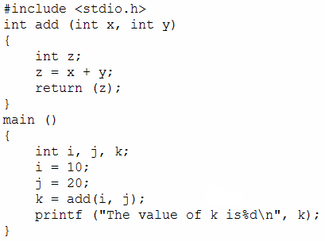
Functions (cont)
EXAMPLE:

Slide 17
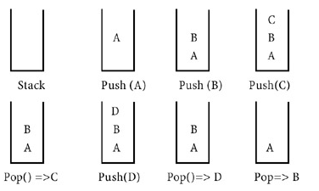
Functions (cont)
The concept of Stack
A stack is memory in which values are stored and retrieved in "last in first out" manner by using operations called push and pop
This method is called last-in first-out (LIFO).

Slide 18
Functions (cont)
Functions or sub-programs are implemented using a stack.
When a function is called, the address of the next instruction is pushed into the stack.
When the function is finished, the address for execution is taken by using the pop operation.

Slide 19
Functions (cont)
The sequence of execution during a function call
  When the function is called, the current execution is temporarily stopped and the control goes to the called function.
  After the call, the execution resumes from the point at which the execution is stopped.

Slide 20
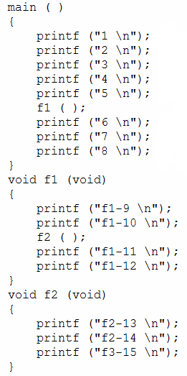
Functions (cont)
EXAMPLE:
The execution sequence is
1 2 3 4 5
f1_9 f1_10
f2_13 f2_14 f2_15
f1_11 f1_12
6 7 8

Slide 21
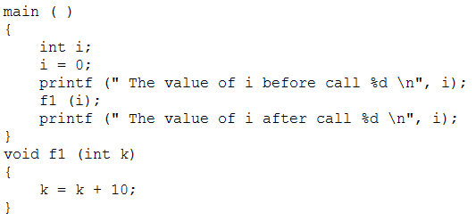
Functions (cont)
Parameter Passing:
  C++ uses the method of parameter passing by value.
  In parameter passing by value, the value before and after the call remains the same.
EXAMPLE:

Slide 22
Functions (cont)
The Concept of Global Variables:
  Global variables can be accessed in all the functions in that file.
  Any update to the global variable also affects the other functions, because all functions refer to the same value of i.
  When you want to share information between multiple functions, you can use the concept of global variables.

Slide 23
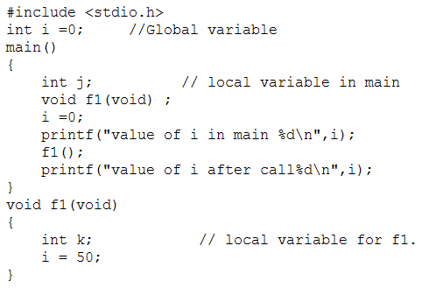
Functions (cont)
EXAMPLE:

Slide 24
Exercises
Write a program using Array and Functions
Amount of data: 3
Data 1: 11
Data 2: 21
Data 3: 7
Maximum number is 21
Minimum number is 7
You have 2 prime number(s): 11 and 7

